Slide 1
Bioinformatics with Python
Real-world tools to make your life easier

Slide 2
Managing Python Versions

Slide 3
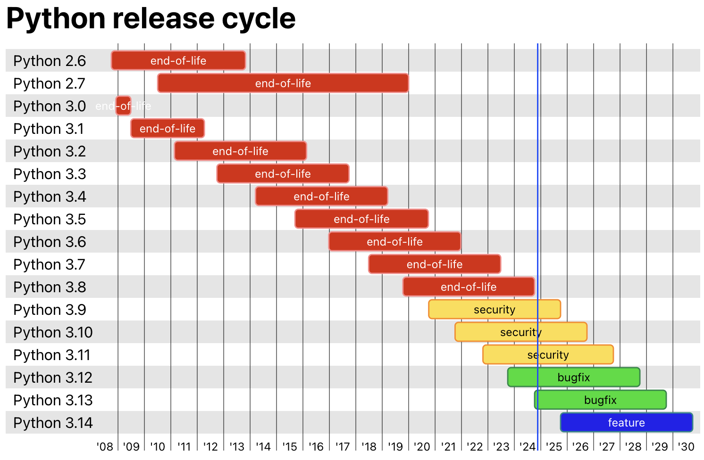
The First Thing to Know About Python Versions: v2 / v3
Python 2 is here
End-of-life is not supported
Python 3.13 is latest
https://devguide.python.org/versions/

Slide 4
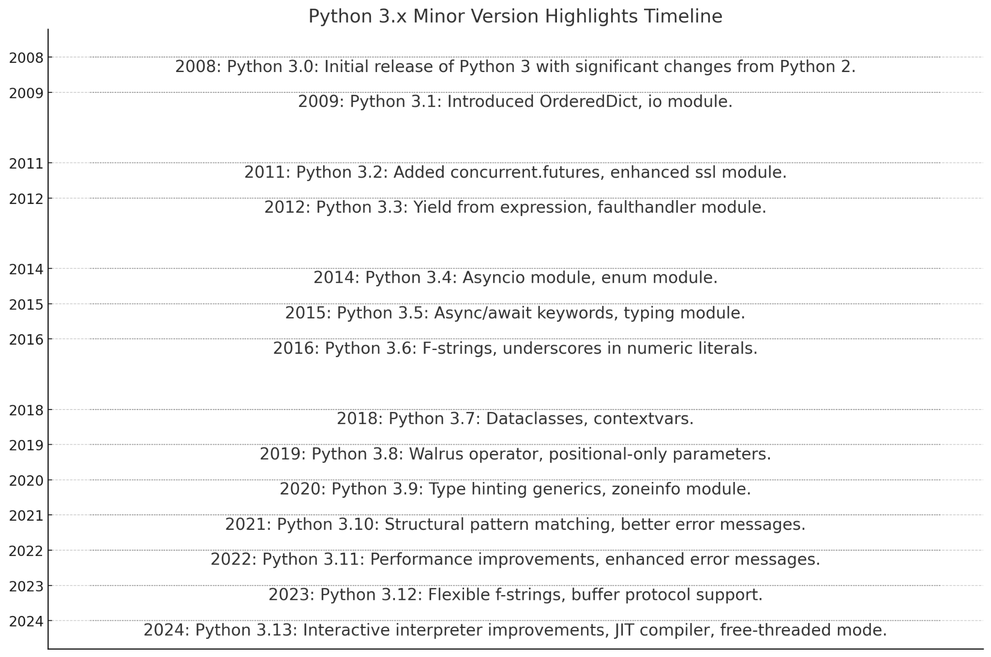
Minor Version Enhancements

Slide 5
Why not just upgrade my system Python to latest?
Backwards-incompatible Enhancements
Python is sometimes used by the Operating System
Minor versions have some deprecated or backwards-incompatible changes (see list at right)
Python software packages may rely on deprecated behavior from earlier Python versions
Python 3.2
Deprecated os.stat_float_times() for file timestamp handling.
Python 3.3
Reintroduced u'' string literal for easier Python 2 compatibility, affecting string handling.
Python 3.5
Introduced async and await as reserved keywords, making their prior use as identifiers invalid.
Python 3.8
Added the walrus operator (:=), potentially conflicting with its use as an identifier.
Modified __import__() function behavior for relative imports.
Python 3.10
Changed abstract base class imports: direct imports from collections deprecated in favor of collections.abc.
Python 3.12
Removed legacy modules (cgi, cgitb, smtpd, etc.) per PEP 594.
Removed wstr representation from Unicode objects, requiring C extension updates.
Python 3.13
Continued removal of outdated APIs and modules as part of ongoing standard library cleanup.

Slide 6
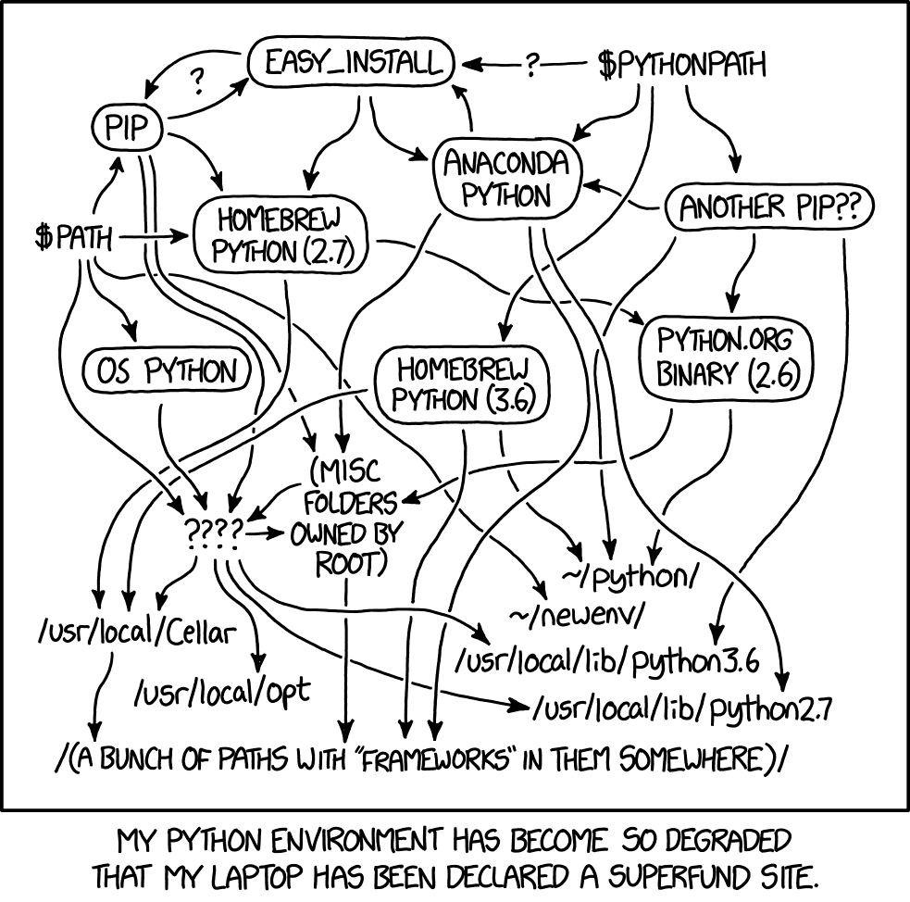
Maintaining multiple Python installations can be messy
https://xkcd.com/1987/

Slide 7
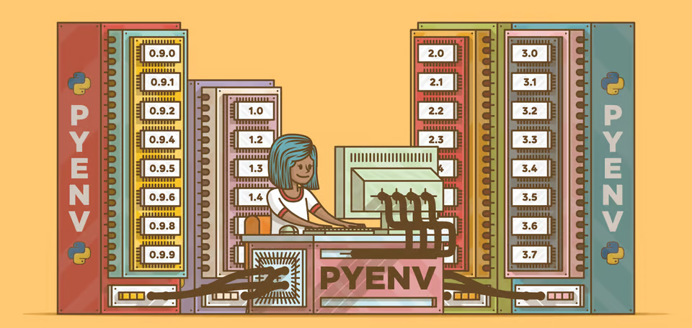
Managing Multiple Python Versions with pyenv
realpython.com/intro-to-pyenv/

Slide 8
pyenv: Getting Started
We have already installed pyenv on the course AMI.
Some additional steps are needed to complete the setup. Let’s do that now.
Go to go.osu.edu/bio-python to:
Install the prerequisite software libraries
Export pyenv executable to PATH environment variable
Get URL for cloning the workspace

Slide 9
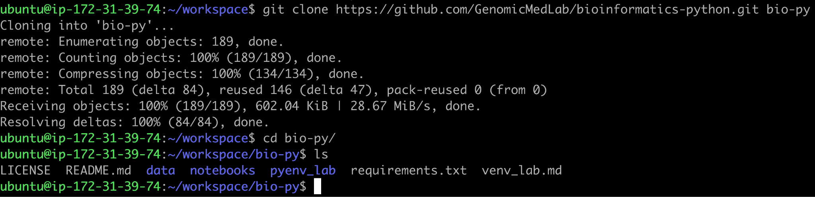
pyenv: Set up your workspace

Slide 10
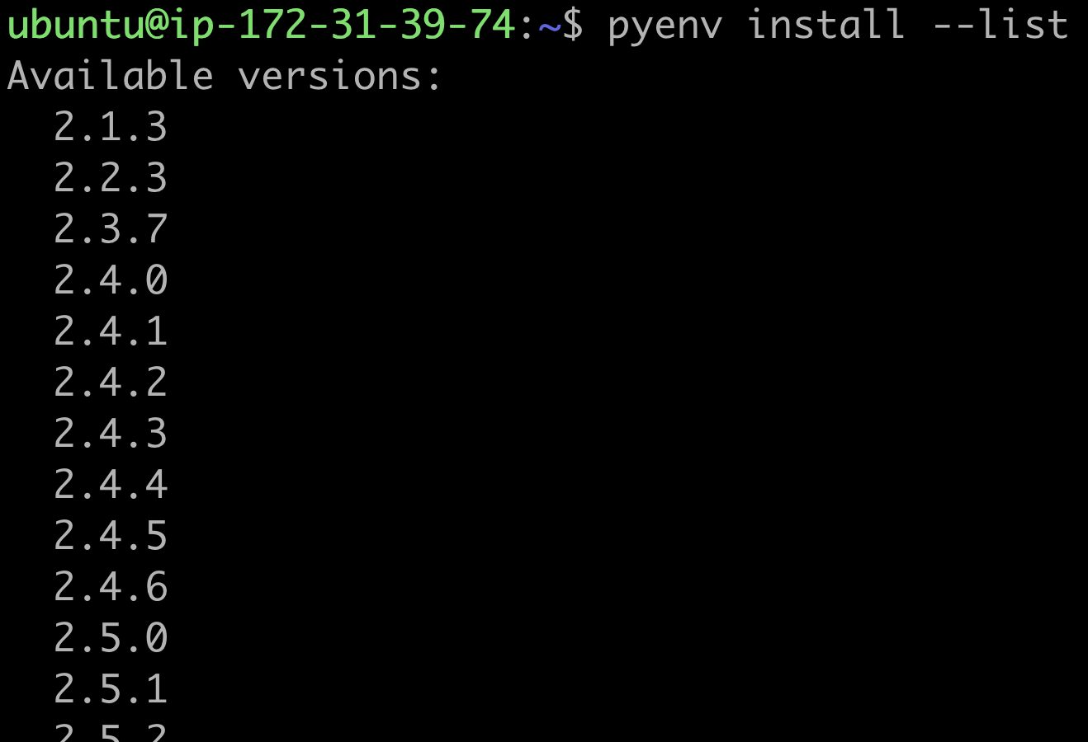
pyenv install --list
In your terminal, see what versions of python are available with pyenv install --list

Slide 11
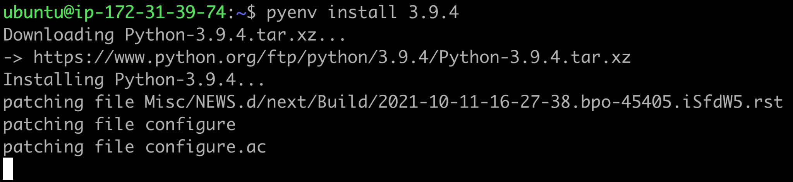
pyenv install <version>
In your terminal install a python version with pyenv install <version>
TIP: auto-resolve the latest patch of a minor version with pyenv install 3.<minor> OR auto-resolve the latest patch of a major version with pyenv install 3

Slide 12
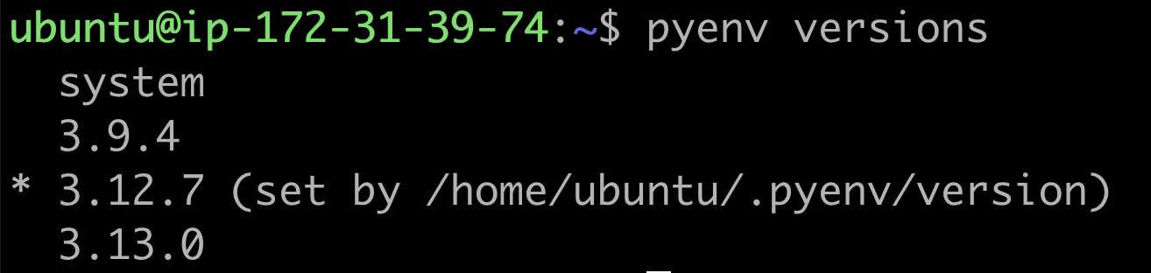
pyenv versions
In your terminal list all the versions currently installed on your EC2 instance with pyenv versions
Note that the currently selected version is indicated by an asterisk (*).
But what does (set by /home/ubuntu/.pyenv/version) mean?

Slide 13
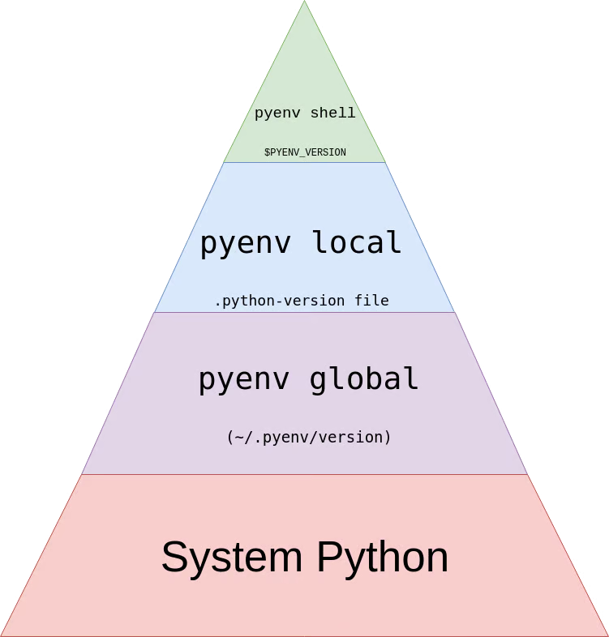
pyenv: How it Works
pyenv lets you set increasingly specific contexts for python version selection, preferentially selecting more specific contexts if defined

Slide 14
pyenv: How it Works
Use this first

Slide 15
pyenv: How it Works
Use this first
Use this if shell not set

Slide 16
pyenv: How it Works
Use this first
Use this if shell not set
Use this if shell and local not set

Slide 17
pyenv: How it Works
Use this first
Use this if shell not set
Use this if shell and local not set
Used as the initial, default value for global

Slide 18
pyenv: How it Works
You are here

Slide 19
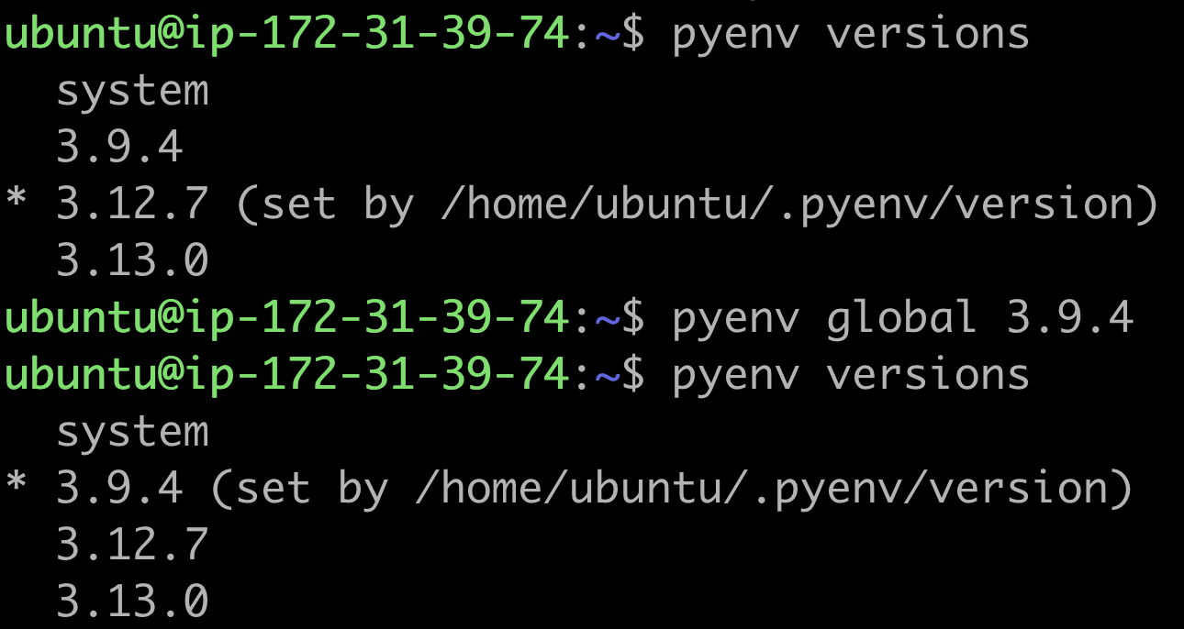
pyenv global
In your terminal set the global version with pyenv global

Slide 20
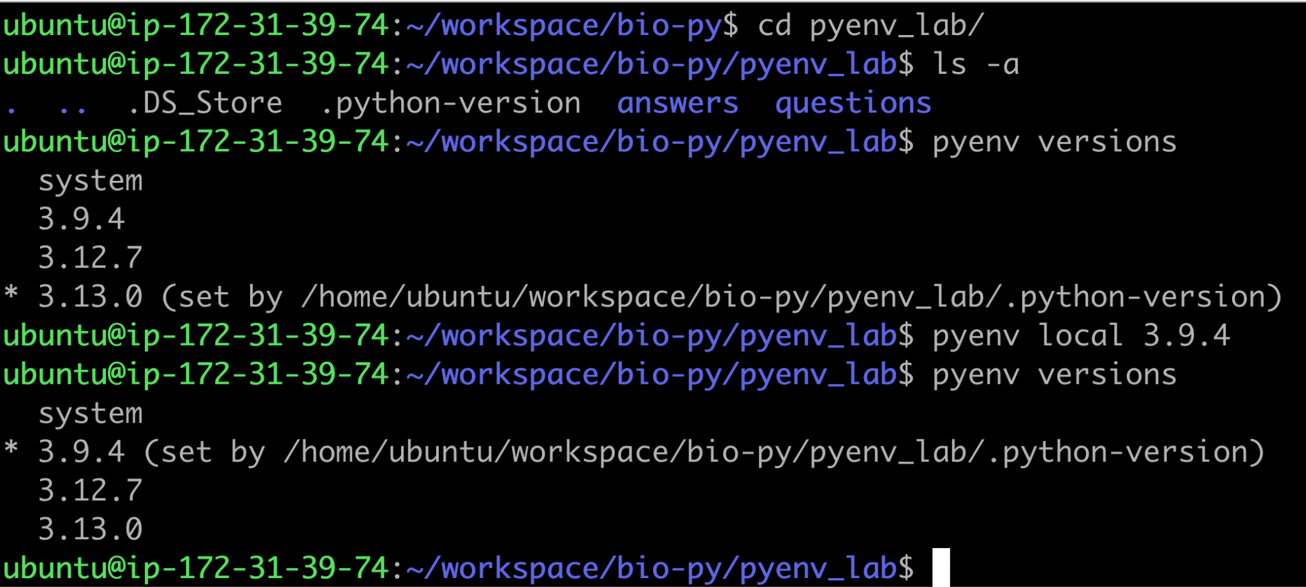
pyenv local
In your terminal set the local version with pyenv local

Slide 21
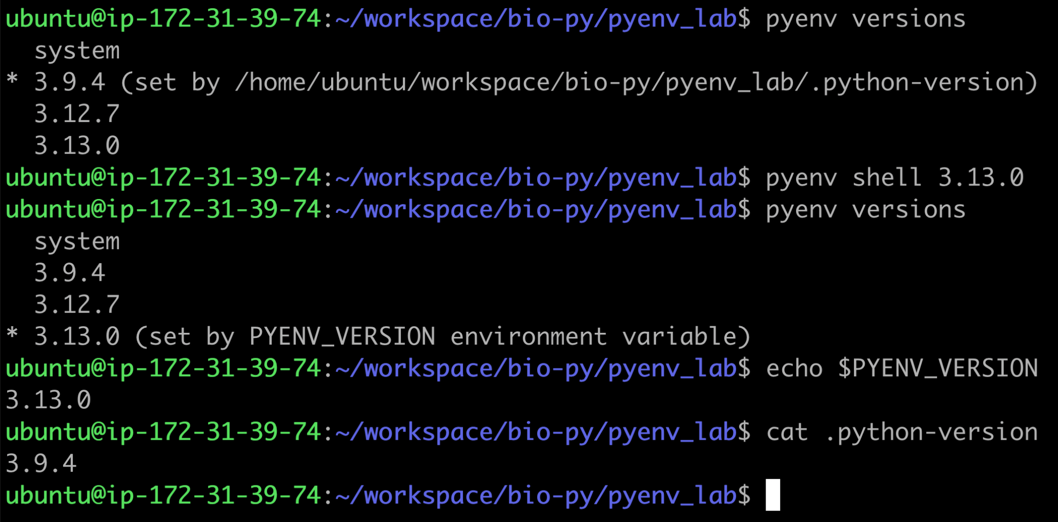
pyenv shell
In your terminal set the shell version with pyenv shell

Slide 22
Review Exercises
In your terminal, identify which python versions are installed on your system. What versions are installed?
Install python version 3.13.0 to your system. Is this version used automatically?
Set a different version as your global default. How can you tell this was set correctly? Will this persist when you start up a new shell? How do you know?
Change to the pyenv_lab directory. What is the currently set python version? Does the set version match the default version you set in the previous exercise? Why or why not?

Slide 23
Managing Python Environments

Slide 24




Why Do We Need Multiple Python Environments?
Dependency Isolation
Keeps project dependencies separate, ensuring one project’s packages don’t interfere with another’s.
Avoid Version Conflicts
Manage multiple versions of Python or libraries for different projects effortlessly.
Simplified Package Management
Install and manage dependencies specific to a project without affecting global Python installation(s).
Reproducibility
Improves consistency in the behavior of your code across different compute environments.

Slide 25

Managing Virtual Environments with the venv module
realpython.com/python-virtual-environments-a-primer/

Slide 26
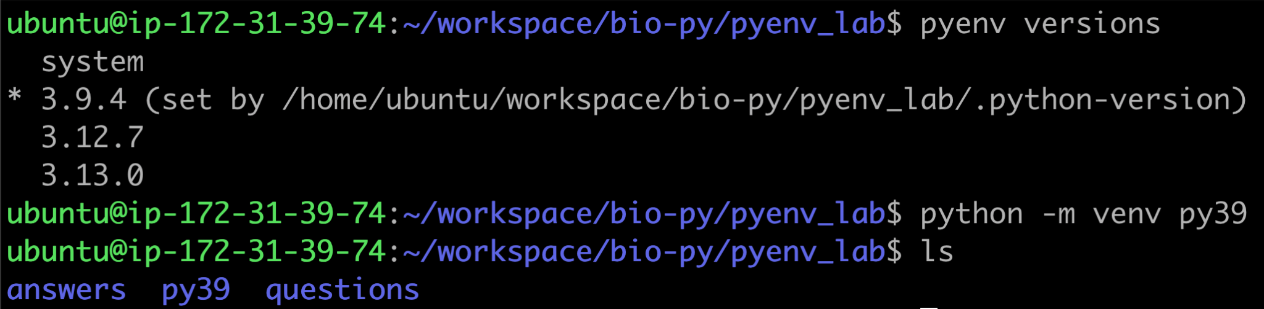
Creating a Virtual Environment with python -m venv
To create a virtual environment with venv:
Call the python version you want to use for the virtual environment
Run the venv module from that python version

Slide 27
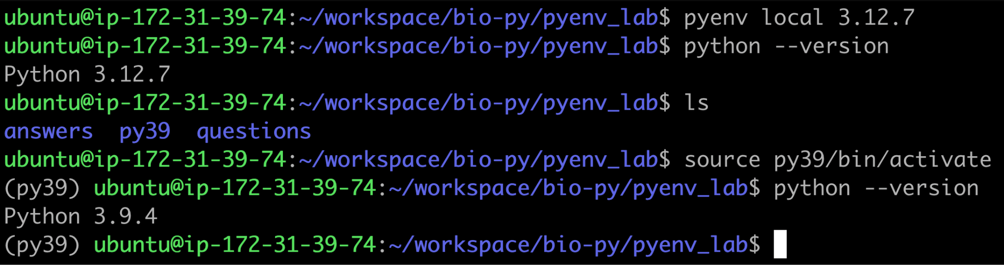
Using a Virtual Environment with bin/activate
To activate a virtual environment, use the source command on the bin/activate script in your virtual environment directory.
When in a virtual environment, it overrides your pyenv version

Slide 28
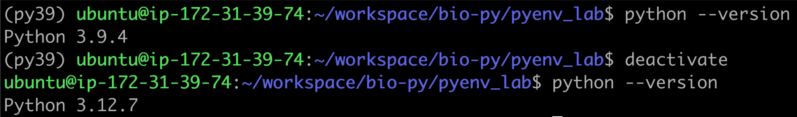
Leaving a Virtual Environment with deactivate
To leave a virtual environment, use the deactivate command

Slide 29
Practical Exercises
Run the following command in the terminal to list the number of installed packages: pip list. How many packages do you see installed? (HINT: remember the wc command from the intro to unix lecture)
Create a new virtual environment in a new directory called venv using python 3.13.0. What command did you use?
Activate the new environment and install the packages listed in requirements.txt. How many packages are installed now?
Leave the virtual environment you activated. What command did you use?

Slide 30
Web Scraping, Pandas, and Pysam

Slide 31
But first–let’s get your Jupyter notebooks set up
Clone fresh copies of bioinformatics-python and variant-interpretation labs
Create a fresh virtual environment in your workspace directory
Install requirements for both labs in your virtual environment
Start up Jupyter Lab from your EC2 instance workspace directory
Retrieve your AWS public IP address
Open up your Jupyter Lab on your local machine

